Slide 1

Social Media Training
JMU Students &
The Community Foundation

Slide 2

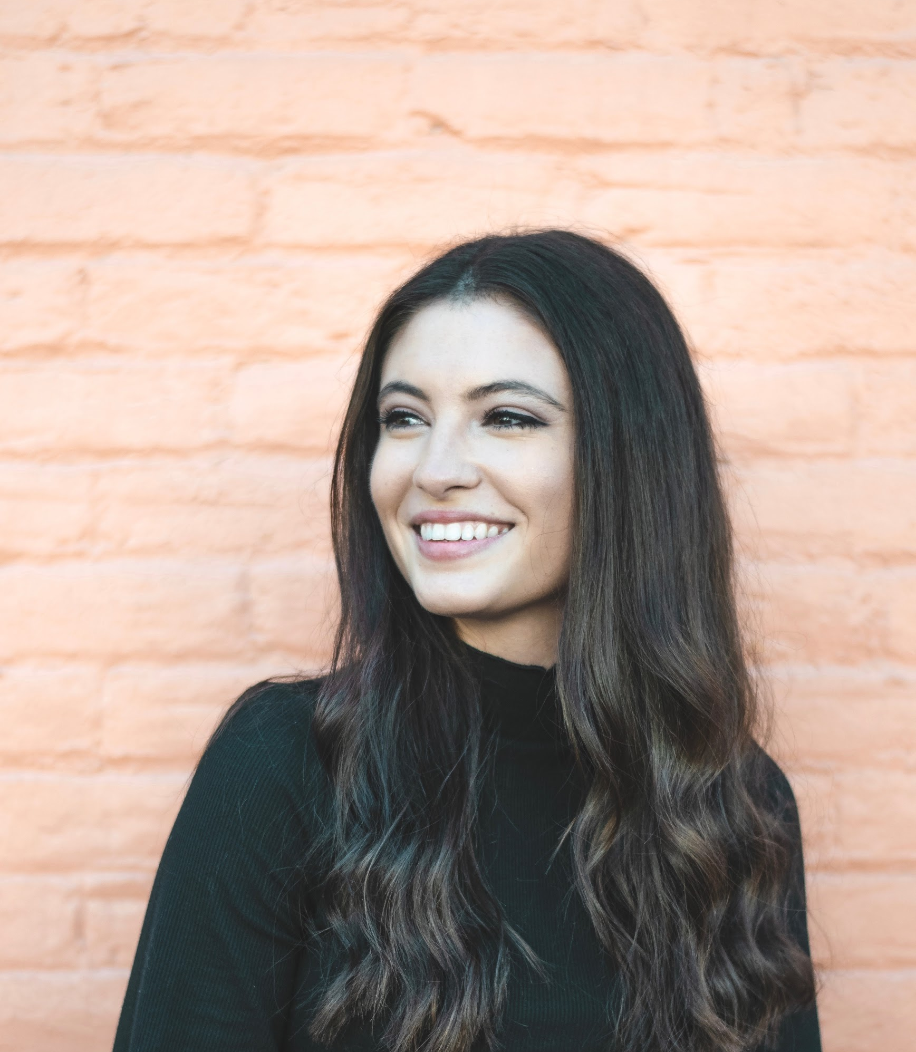
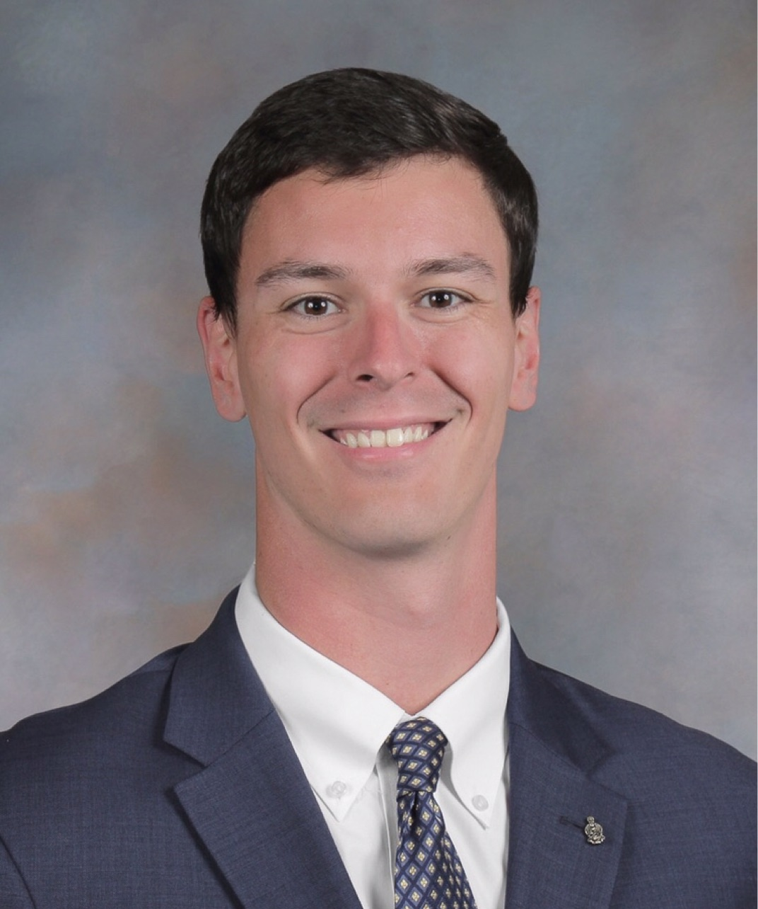
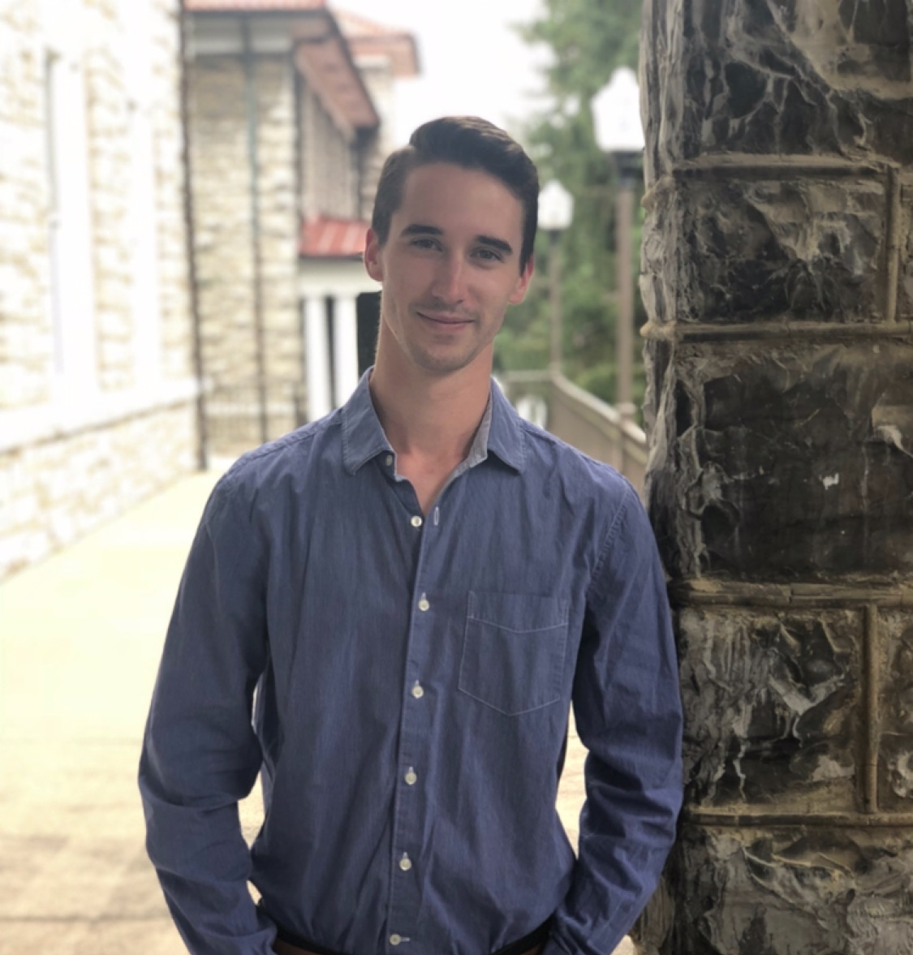
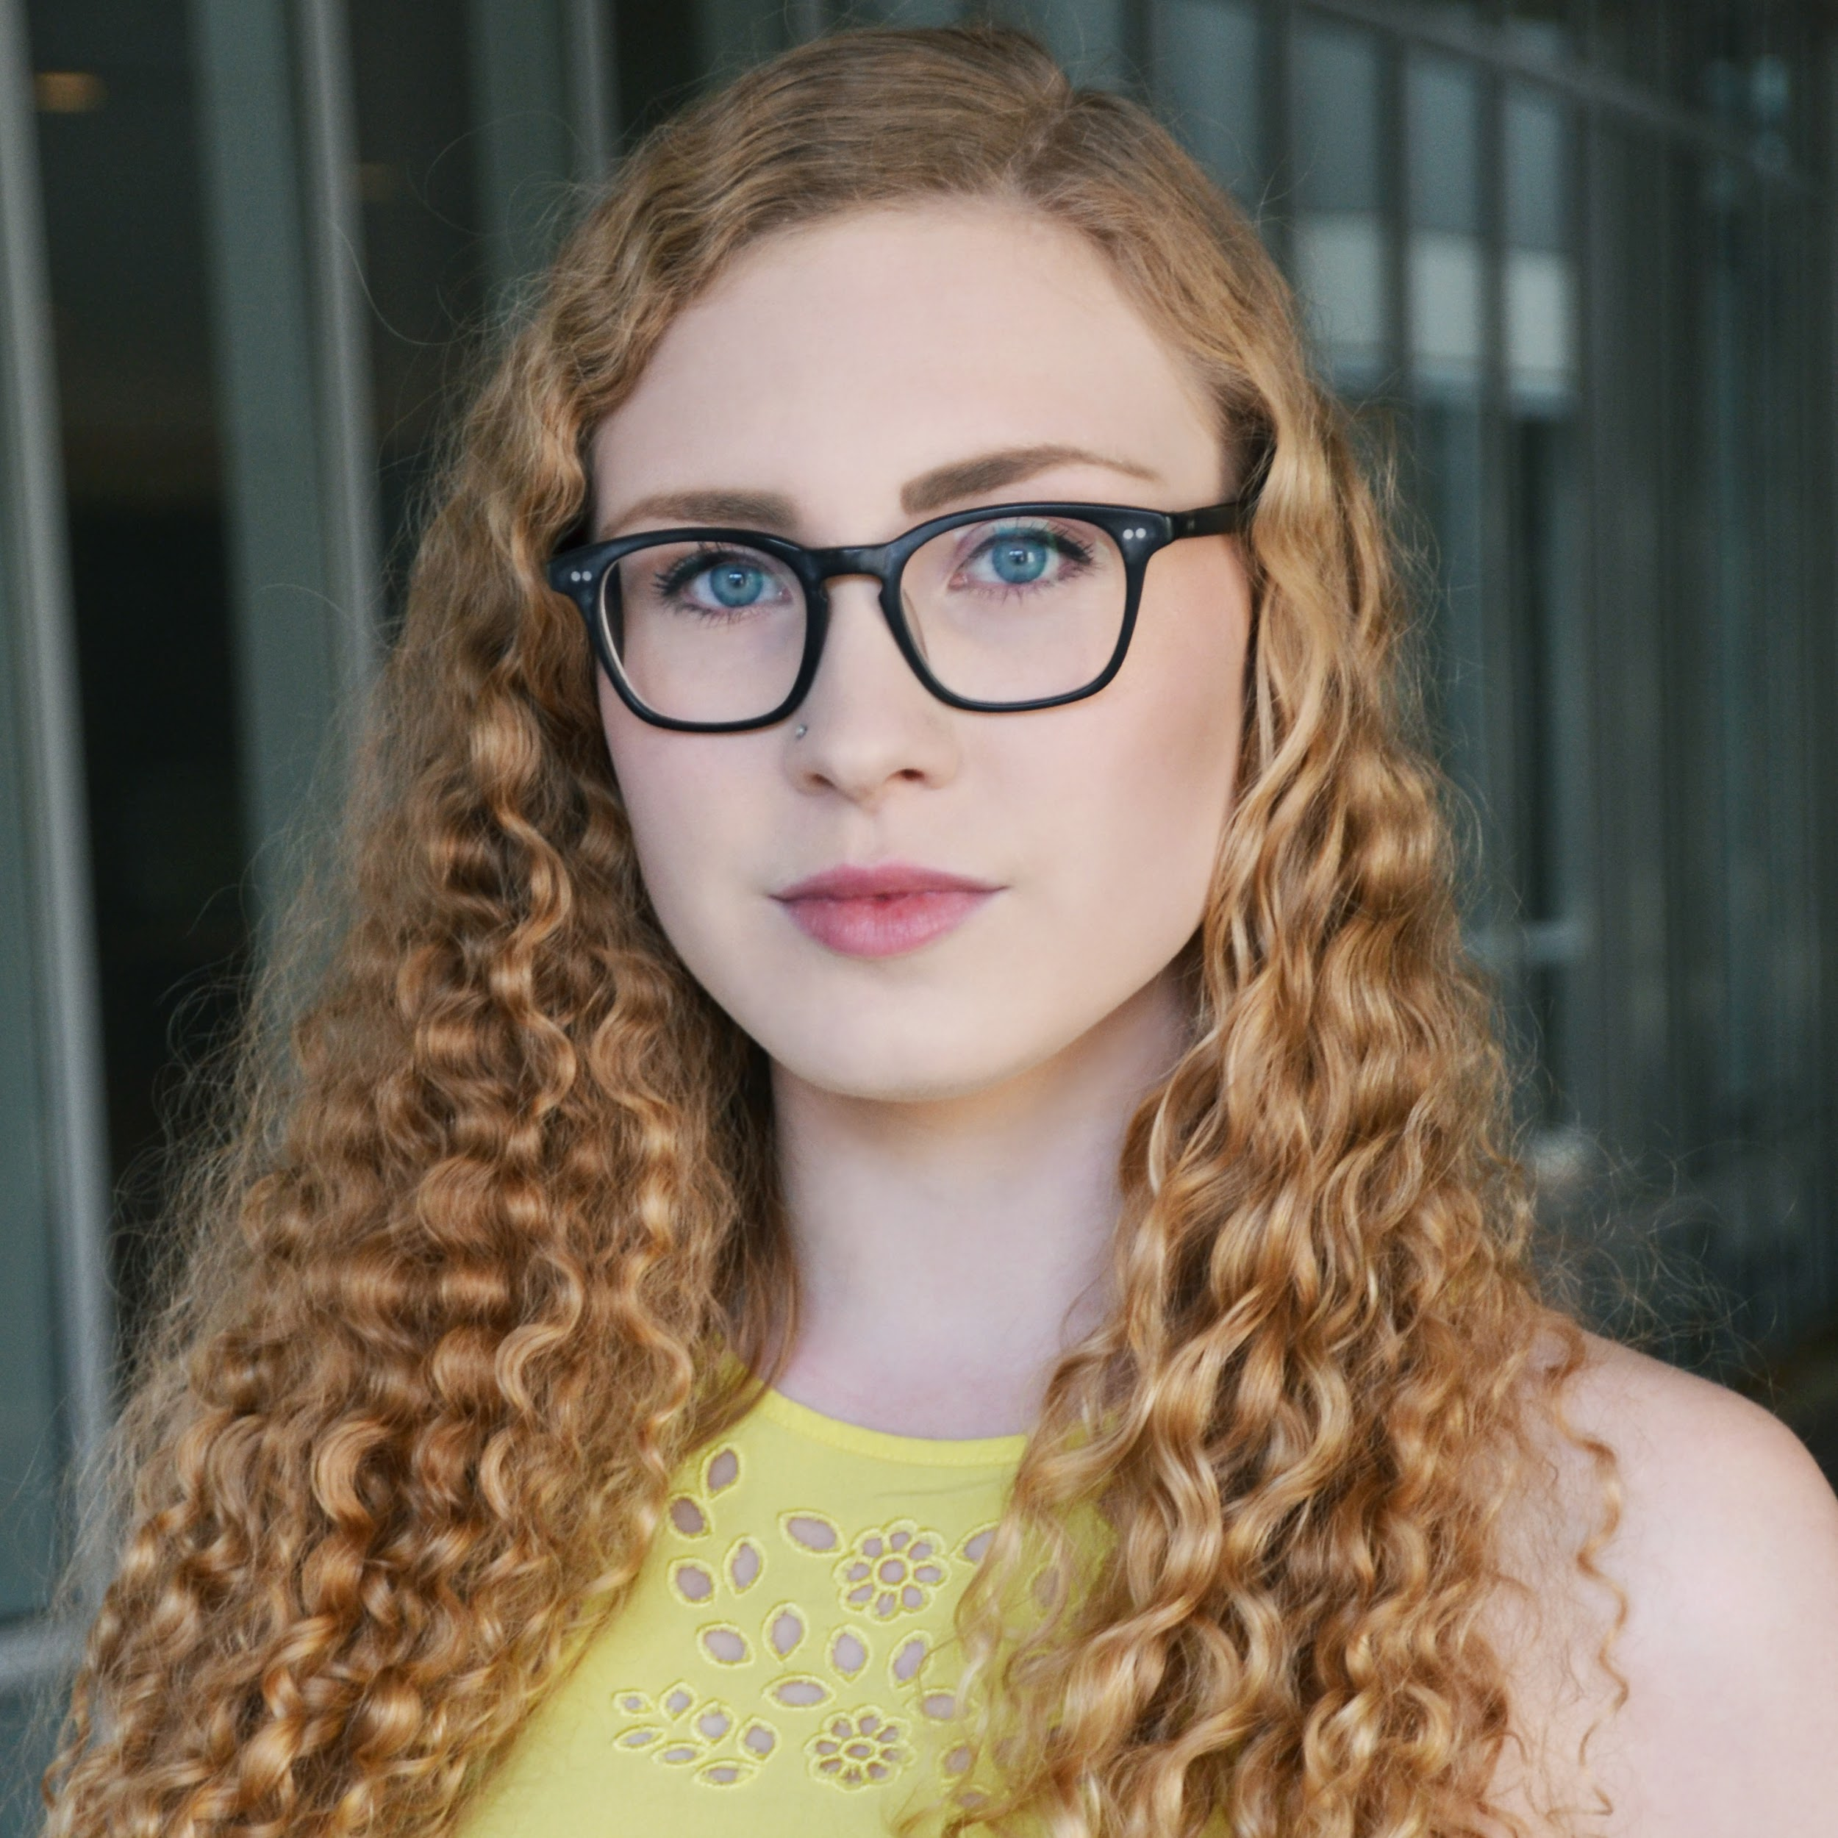
HELLO!
‹#›
Notes:
Everyone

Slide 3
Agenda
Training Objectives
Takeaways
Icebreaker
Follow Spree!
Social Media Platforms
Group Post
Branding & Content Tools
Social Media Plan
Workshop: Creating a social media post for Great Community Give
Debrief & Question and Answer
Notes:
Kaitlynn

Slide 4
Training Objectives
Understand the overall idea of the social media platforms
Introduce new creation tools
Learn how to increase awareness of your organization
Notes:
Conor

Slide 5
Takeaways
You will leave this training with...
An effective social media post about the Great Community Give
The foundation of a social media plan
A useful handout about this presentation
Connections with other community partners
Notes:
Brian

Slide 6
ICEBREAKER
Guess the popular TV & movie theme song!
Notes:
Brian

Slide 7
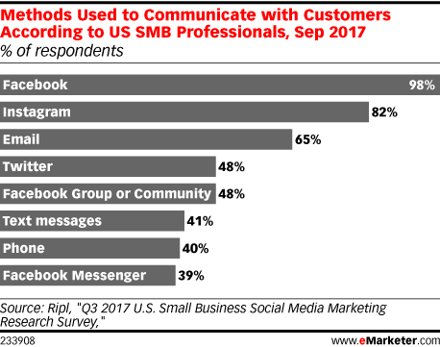
Why social media?
Notes:
Conor
Small Business Professionals

Slide 8
Follow Spree!
Go to this link and submit your organization’s social media usernames!
After we share the responses, follow your fellow non-profits!
https://contactinformation.page.link/Gcg
Notes:
Sky

Slide 9
Instagram
Quick facts
Instagram has the most viewed stories
The average age of users is between 18-30 years old
There are roughly 1.5 billion active accounts
Instagram is the second most-used social media platform, right behind facebook
#1 social media platform for personal or professional use
Notes:
brian

Slide 10
Instagram
How do you brand your company?
Attract followers
Post relevant information to your audience
Create a flowing layout on your main page
  Website URL, permanent videos (“Highlights”), interesting bio, easy to find Instagram tag
Have your profile open to the public: why?

Slide 11
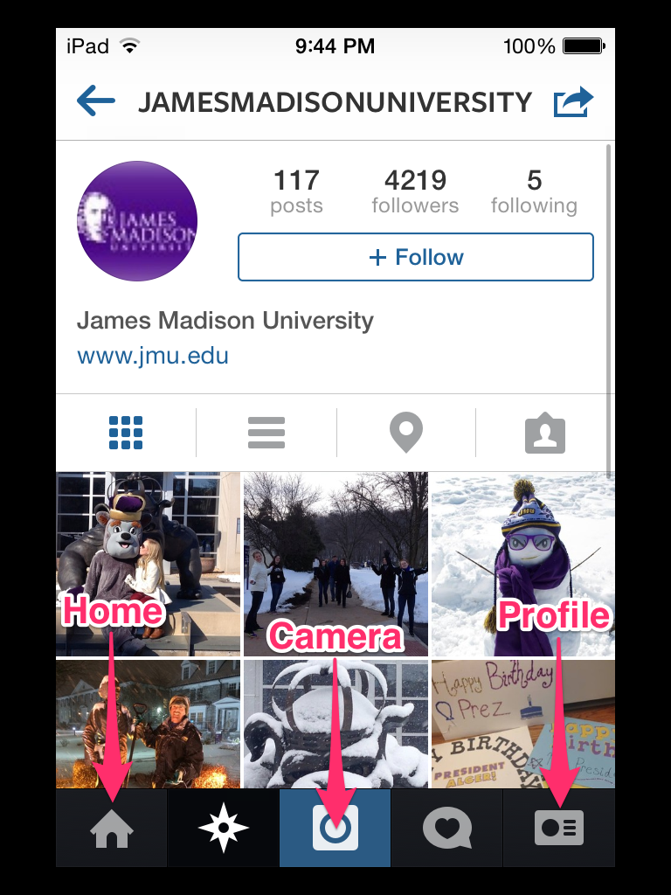
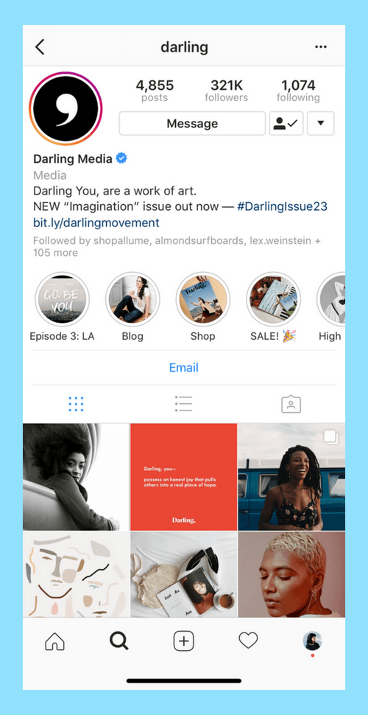

Slide 12
Instagram: Pros & Cons
Pros
Creativity
Public reach
Personal branding
Very popular
Pay advertisers
Cons
Constant maintenance
Possibility for controversy
Chance of getting hacked
Not a source for large amounts of information

Slide 13
Instagram
Avoid these when branding your organization:
1- Watch what you say
2- Watch what you post
3- Watch what acquaintances post on your pages
4- Watch what you are tagged in
All of these add up to a larger picture!

Slide 14

Facebook

Slide 15
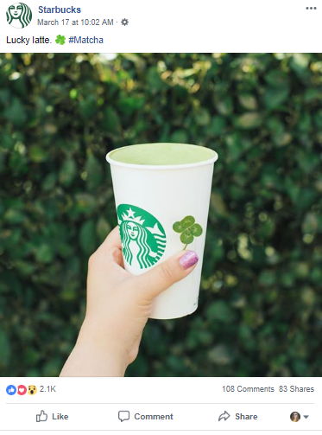
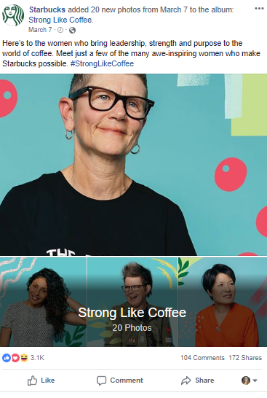

Slide 16
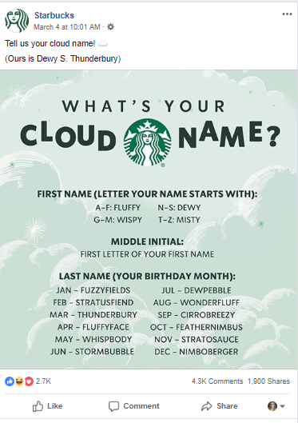
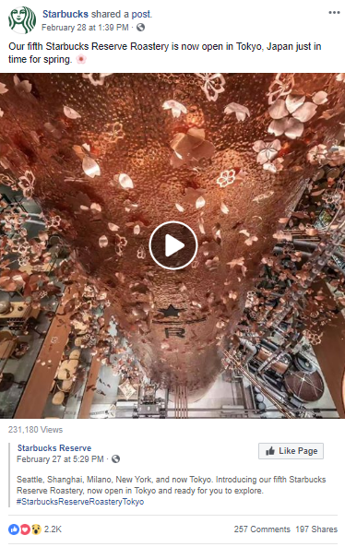

Slide 17
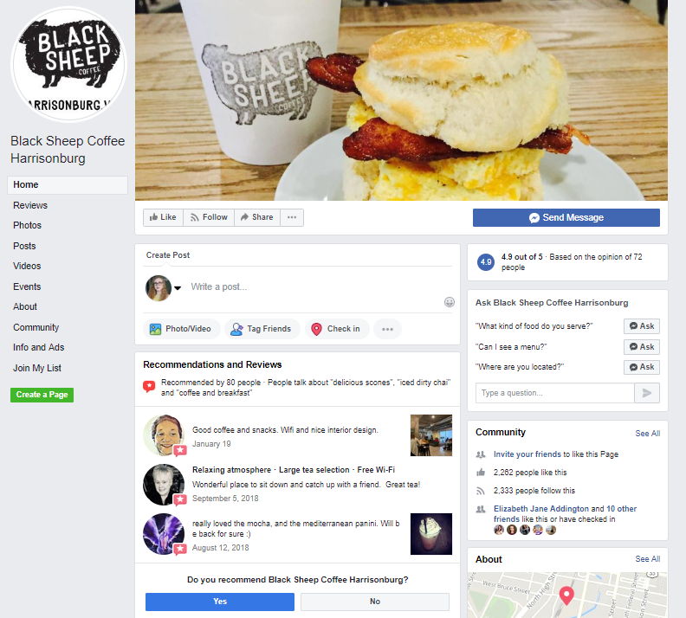

Slide 18
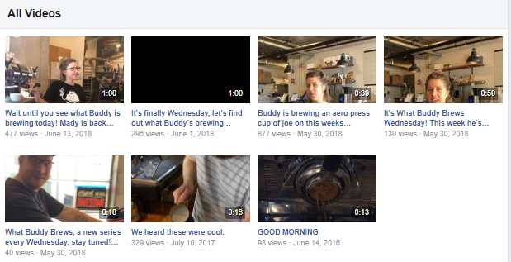
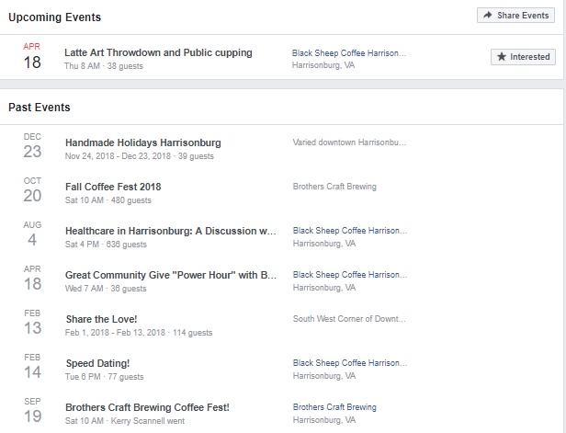

Slide 19
Facebook: Optimization
Ideal post amount: 5-10 times a week
Ideal posting time: 1-3p.m., especially Thursday and Friday
Use all of Facebook’s features
  Examples: Messenger, Groups, Events, Facebook Live, Stories
Diversify post types
Perfect your photos
  Cover photos: 851 pixels wide by 315 pixels high
  Photos in posts: 1,200 pixels wide by 628 pixels high
Encourage volunteers and friends to share your page’s posts

Slide 20
Twitter
Why it’s helpful:
Market Research
Immediacy
More intimate

Slide 21
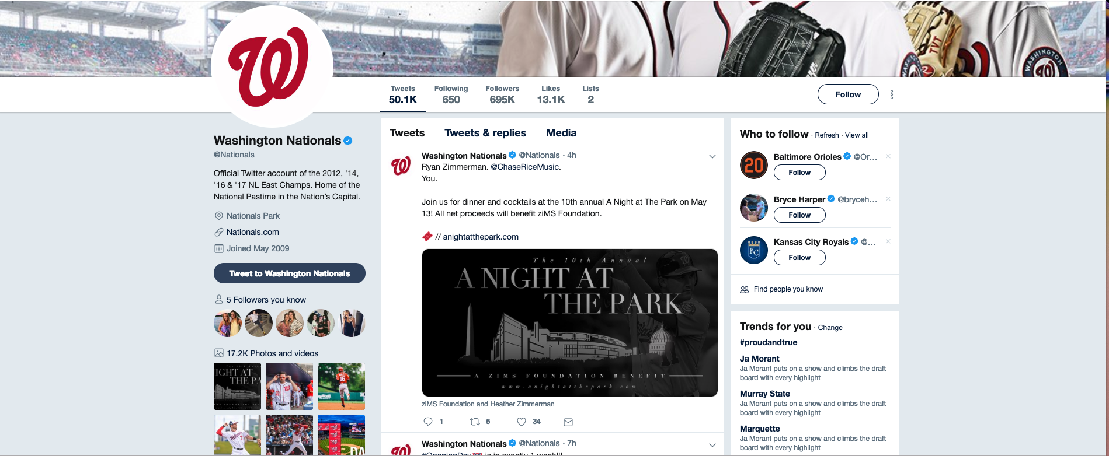

Slide 22
Twitter
How to optimize Twitter for your business:
Best time to post: 3 p.m. Monday to Friday.
Branding opportunity
Biographies
Who to follow:

Slide 23
Twitter
Best Tweeting Practices
Twitter’s Tweet formula, two of:
  Insight
  Personality
  Information
Authentic
Rich Media
Connect
Visibility
Documentation
Amplification

Slide 24
What questions
do we have?
Notes:
Brian

Slide 25
GROUP POST
Get into groups of 3 , take a picture and create a practice post with a caption.
Notes:
Sky

Slide 26
Branding
A
B
C
authentic
backed
consistent

Slide 27
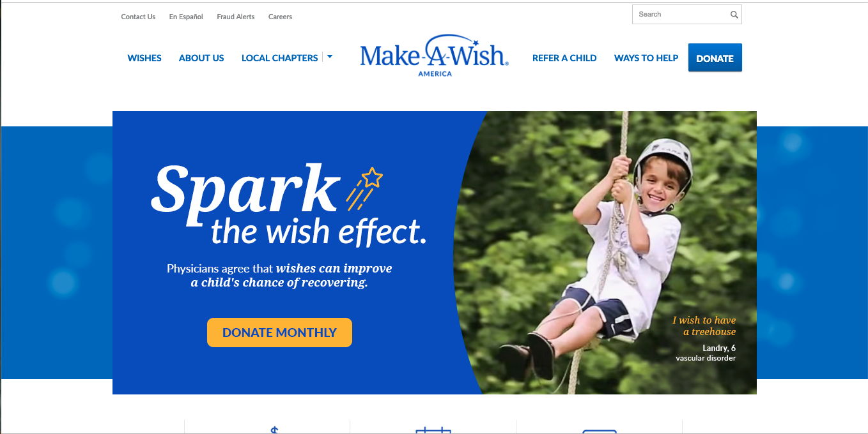
Notes:
Logo which includes name

Slide 28
Notes:
Logo which includes name

Slide 29
Notes:
description/ motto

Slide 30
Notes:
Font- Consistent and on brand

Slide 31
Notes:
Blue white and Yellow color scheme

Slide 32
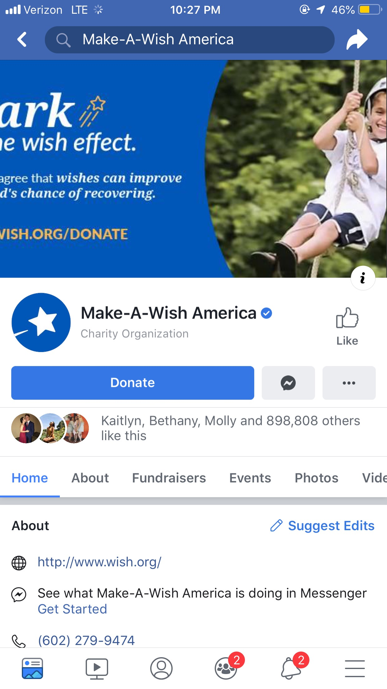
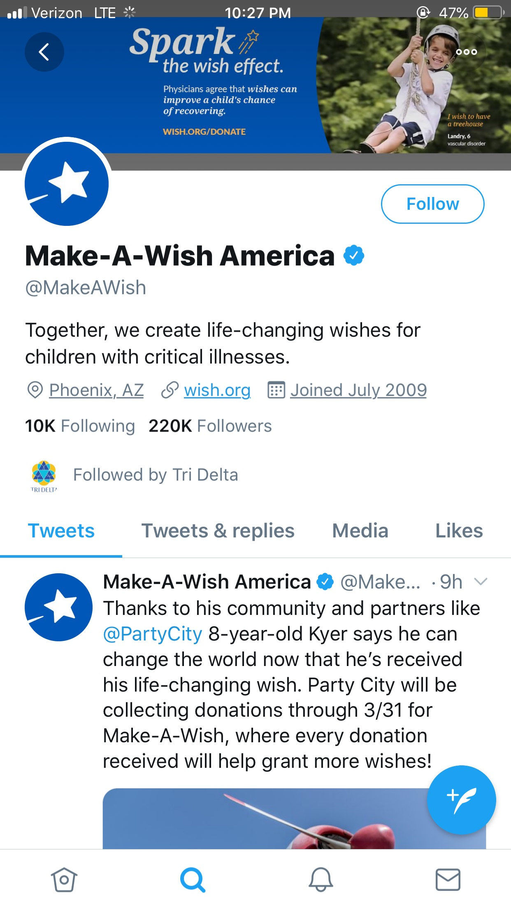
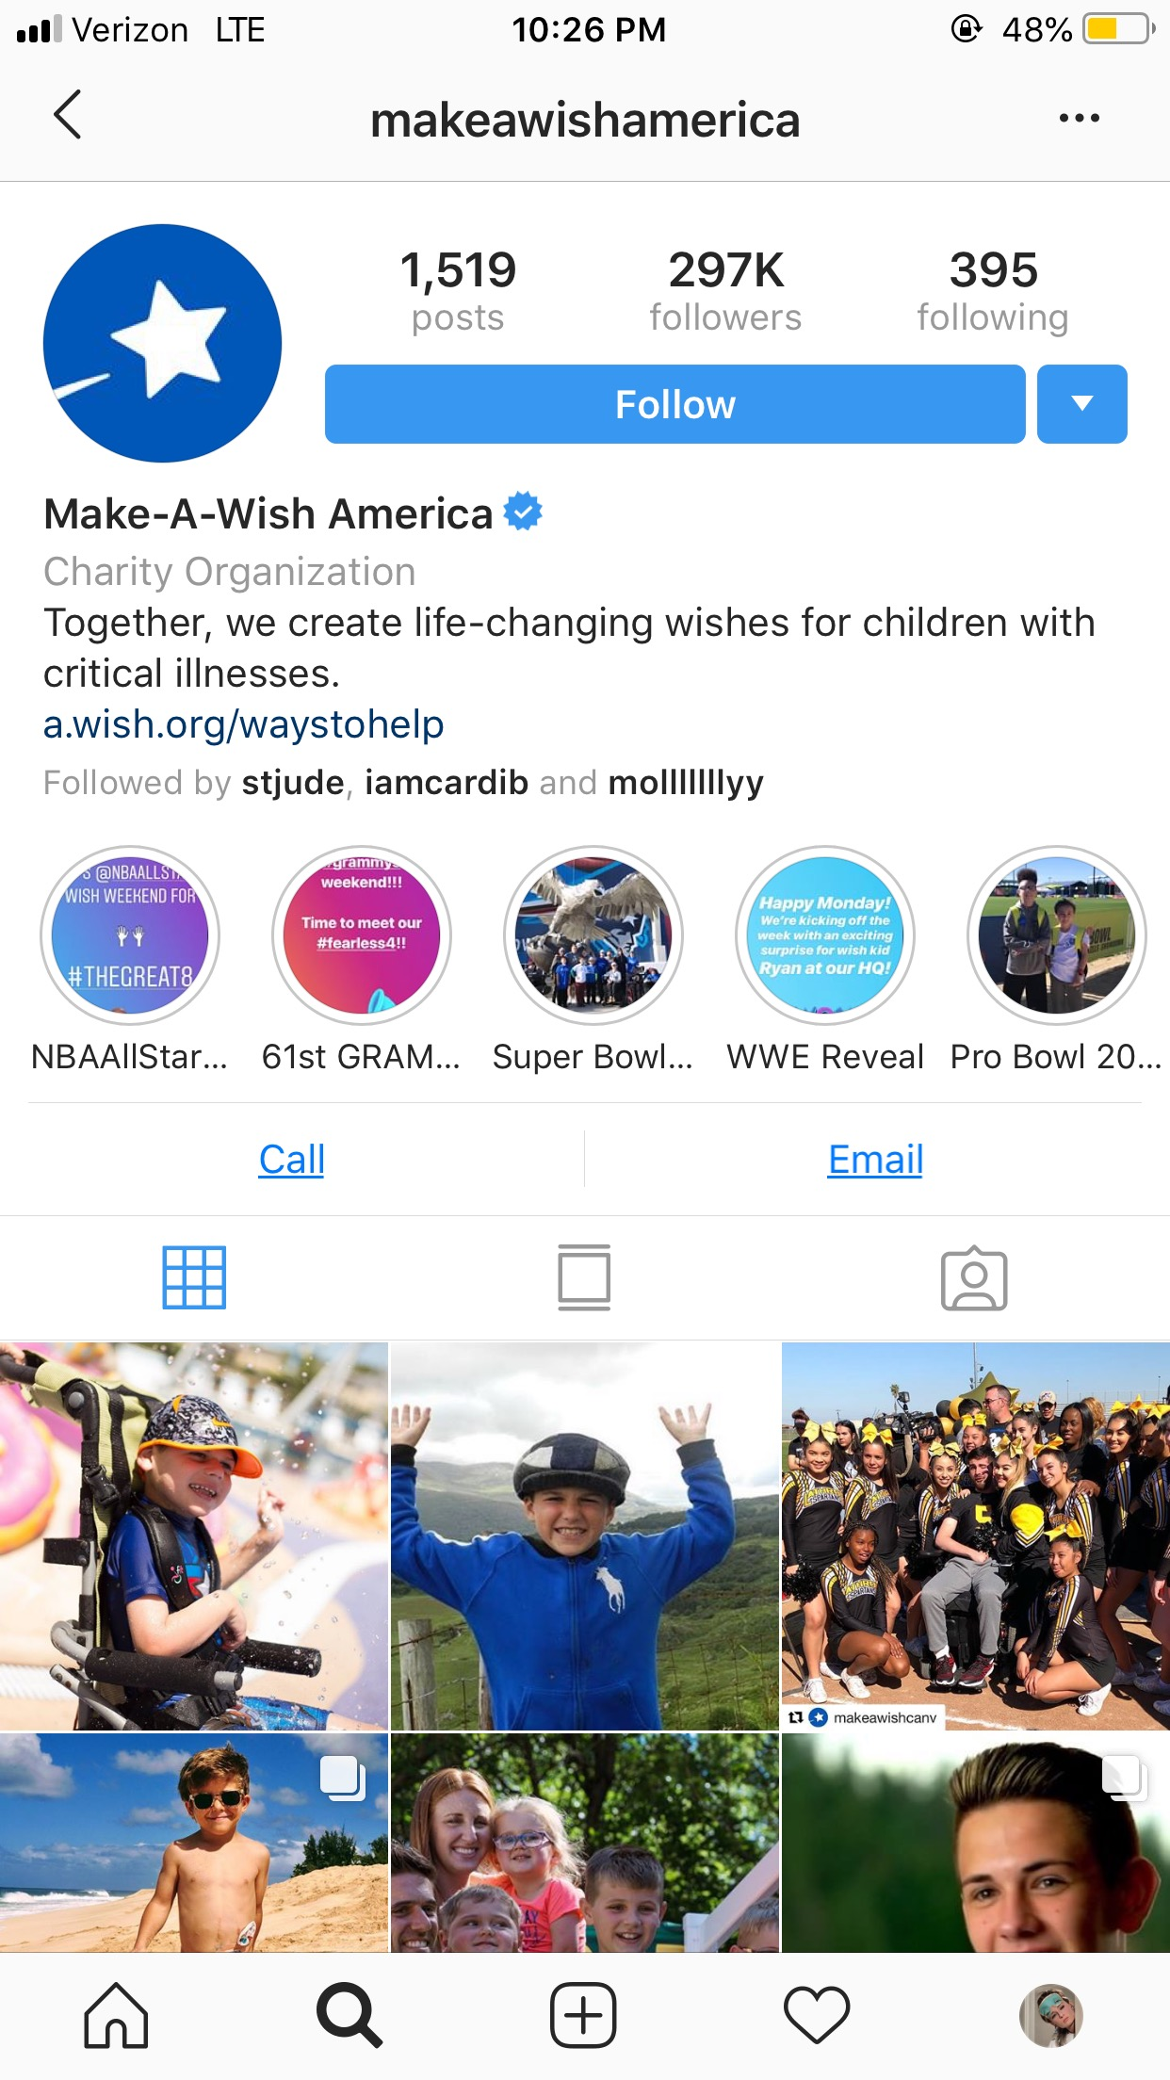

Slide 34
fresh
earthy
calming
positive
loyalty
reliable
trust
harmonious
majestic
vibrant
royal
creative
bright
positivity
warmth
energetic
confident
happy
friendly
positive
strength
passionate
dynamic
bold
powerful
formal
classic
elegant
techy
sleek
modern
open

Slide 35
Raleway
Quicksand
Playfair
Oswald
Karla
Poiret One
Courier New
Syncopate
Calligraffitti
Satisfy
Amatic
Pacifico

Slide 36

Logos

Slide 37


Slide 39


Slide 40


Slide 42


Slide 43
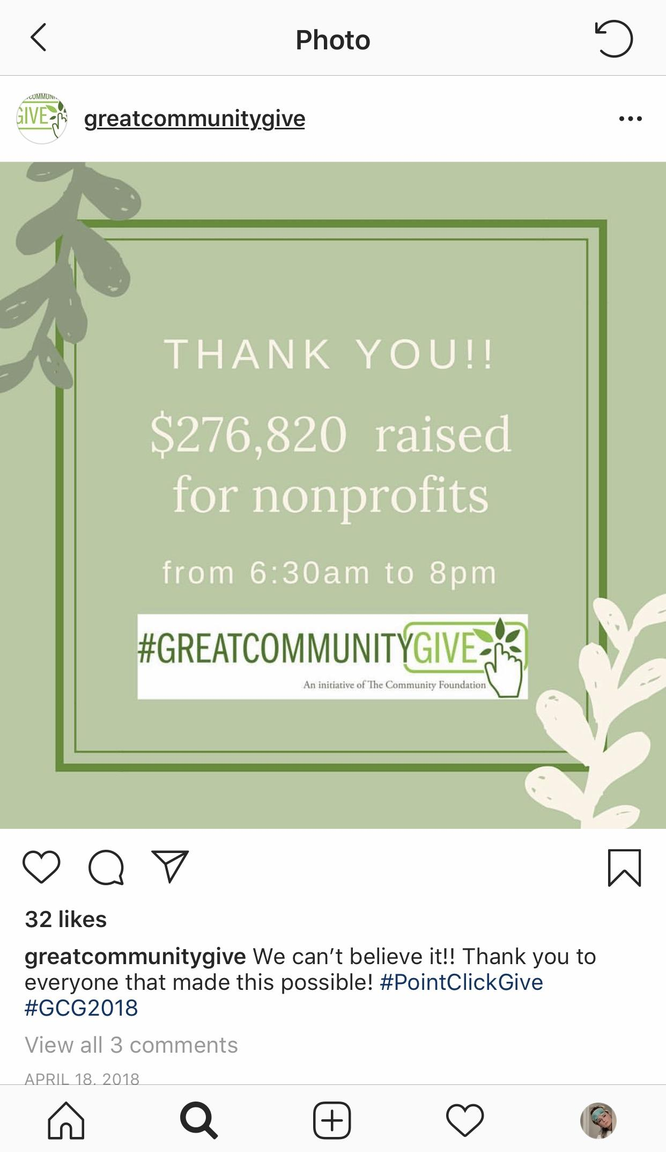

Slide 44
Branding
Consistent brand
Recognizable
Colors and fonts evoke
emotions to the audience
Rule of Three

Slide 45
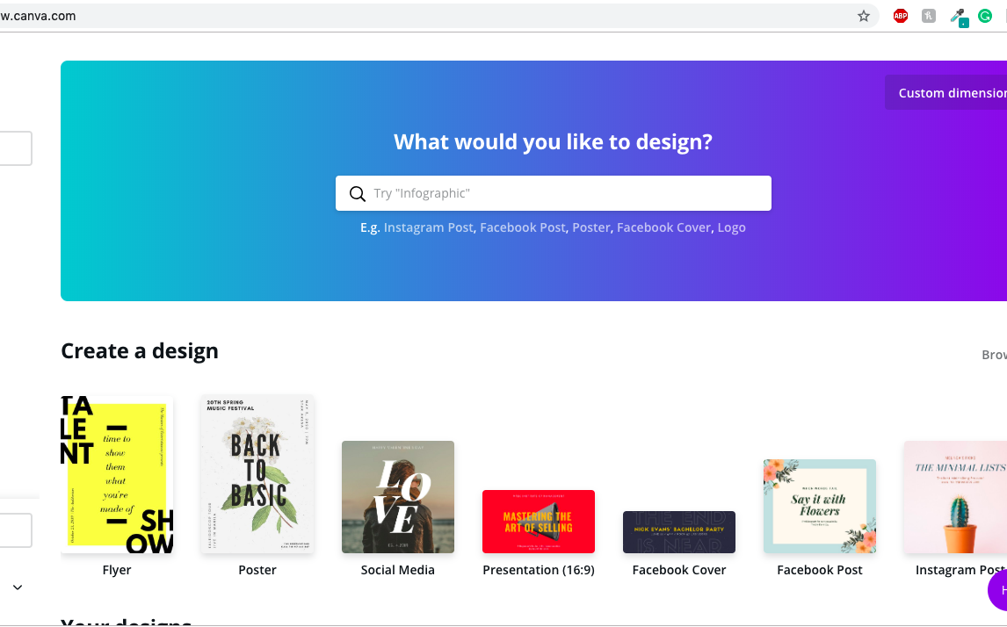
Content Creation
Place your screenshot here
www.canva.com

Slide 46
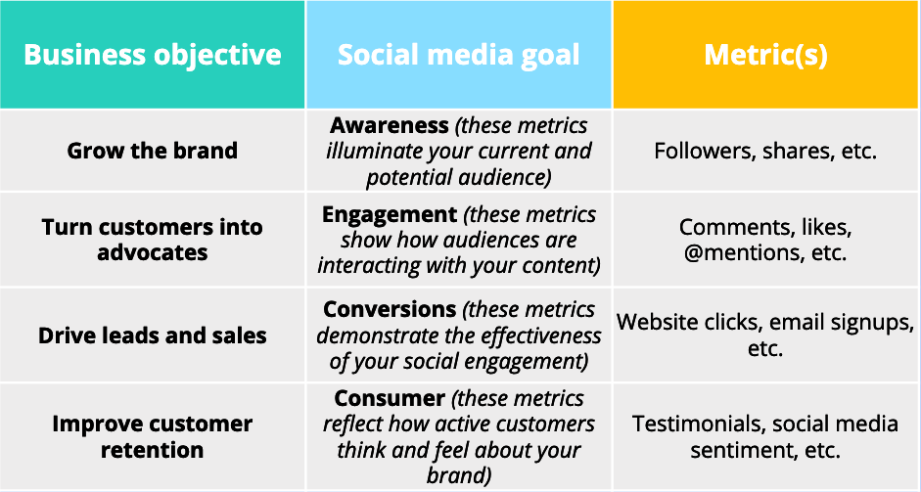
Social Media Plan: Goals

Slide 47
WORKSHOP
Take the next 20 minutes to use the creation tools we learned to create a social media post about the
Great Community Give
Notes:
Kaitlynn

Slide 48
Debrief
What information did you have coming into this training session?
What’s your biggest takeaway from this session?
Which of the three social media platforms that we discussed today
is your favorite?
How is your social media use going to change after this training?
Notes:
All

Slide 49
THANKS!
Any questions?
Feel free to contact us at
jmucommtraining@gmail.com
Notes:
Kaitlynn

